Slide 1

Brindavan College of Engineering
Department of Computer Science and Engineering
A Project Presentation on
“Fraudify-Fighting Financial Crime With Machine Learning”
Under the Guidance of
Prof,Smitha B.M
Dept of CSE, BrCE
Presentation By: Group-18
Name USN
THEJASHREE C G 1BO21CS064
VAISHALI G V 1BO21CS065
VIBHA S GOWDA 1BO21CS066
CHARANA R 1BO22CS405

Slide 2


AGENDA
AGENDA
Aim and Objective
Problem Statement
Abstract
Introduction
Literature Survey
Existing System(Problem Identification)
Proposed System (Objective and Methodology)
System Requirements Specification
System Design
References
Modules
Implementation

Slide 3
AIM OF THE PROJECT
Build an automated fraud detection system for UPI transactions.
Use machine learning algorithms to detect fraudulent transactions based on transaction history, user behavior, and other relevant features.
Achieve a high degree of accuracy while minimizing false positives and false negatives in fraud detection.
Design a system that can operate in real-time, providing quick alerts for suspected fraudulent activities.
Enhance user trust in UPI-based transactions by improving security measures through proactive fraud detection.

Slide 4
OBJECTIVE OF THE PROJECT
The objective of this project is to develop an effective machine learning-based system that can automatically detect and flag fraudulent transactions within the Unified Payments Interface (UPI) ecosystem. By analyzing user transaction patterns and behaviors in real-time, the system aims to differentiate between legitimate and fraudulent transactions, providing a robust solution to minimize financial losses and secure digital payments.

Slide 5
PROBLEM STATEMENT
The rise of digital payments via UPI has led to an increase in fraudulent transactions, including unauthorized transfers, phishing, and account hacking.
Traditional methods for fraud detection are not sufficiently dynamic to handle the volume and complexity of transactions in real-time.
there is a need to develop an advanced fraud detection system using machine learning techniques to ensure the security and trustworthiness of UPI transactions.

Slide 6
ABSTRACT
crease in UPI usage for online payments
cases of fraud associated with it are also rising.
Few steps involving UPI transaction process using a Hidden Markov Model (HMM)
An HMM is initially trained for a cardholder.
If a UPI transaction is not accepted by the trained HMM. It is considered to be fraudulent.
People can use UPIs for online transactions as it provides an efficient and easy-to-use facility.
With the increase in usage of UPIs, the capacity of UPI misuse has also enhanced.
UPI frauds cause significant financial losses for both UPI holders and financial companies.
In this Project, the main aim is to detect such frauds, including the accessibility of public data, high-class imbalance data, the changes in fraud nature, and high rates of false alarm.
The main focus has been to apply the recent development of Machine Learning algorithms for this purpose.
Notes:
The system is based on three major stages: colour segmentation, recognition, and classification.
a)Four colour segmentation algorithms are developed and tested.
They are shadow and highlight invariant, a dynamic threshold, a modification of de la Escalera’s algorithm and a Fuzzy colour segmentation algorithm.
All algorithms are tested using hundreds of images and the shadow-highlight invariant algorithm is eventually chosen as the best performer. This is because it is immune to shadows and highlights. It is also robust as it was tested in different lighting conditions, weather conditions, and times of the day.
Approximately 97% successful segmentation rate was achieved using this algorithm.
b) Recognition of traffic signs is carried out using a fuzzy shape recogniser.
Based on four shape measures - the rectangularity, triangularity, ellipticity, and octagonality, fuzzy rules were developed to determine the shape of the sign. Among these shape measures octagonality has been introduced in this research.
The final decision of the recogniser is based on the combination of both the colour and shape of the sign.
The recogniser was tested in a variety of testing conditions giving an overall performance of approximately 88%.
c) Classification was undertaken using a Support Vector Machine (SVM) classifier. The classification is carried out in two stages: rim’s shape classification followed by the classification of interior of the sign. The classifier was trained and tested using binary images

Slide 7
INTRODUCTION
Unified Payments Interface (UPI) is one of the most widely adopted digital payment systems in India, allowing users to send and receive money instantly, 24/7.
UPI provides a seamless and user-friendly experience, making it the preferred method of payment for many. However, with the growing use of UPI, there has been an increase in fraudulent activities such as phishing attacks, account takeovers, and fake transactions
Detecting fraud in real-time is crucial to prevent financial losses and protect users from potential scams.
Traditional methods of fraud detection, such as rule-based systems, often fall short due to their inability to adapt to evolving fraud tactics. Therefore, there is a growing need for automated, data-driven systems that can analyze vast amounts of transactional data to identify fraudulent behavior patterns.
Notes:
The system is based on three major stages: colour segmentation, recognition, and classification.
a)Four colour segmentation algorithms are developed and tested.
They are shadow and highlight invariant, a dynamic threshold, a modification of de la Escalera’s algorithm and a Fuzzy colour segmentation algorithm.
All algorithms are tested using hundreds of images and the shadow-highlight invariant algorithm is eventually chosen as the best performer. This is because it is immune to shadows and highlights. It is also robust as it was tested in different lighting conditions, weather conditions, and times of the day.
Approximately 97% successful segmentation rate was achieved using this algorithm.
b) Recognition of traffic signs is carried out using a fuzzy shape recogniser.
Based on four shape measures - the rectangularity, triangularity, ellipticity, and octagonality, fuzzy rules were developed to determine the shape of the sign. Among these shape measures octagonality has been introduced in this research.
The final decision of the recogniser is based on the combination of both the colour and shape of the sign.
The recogniser was tested in a variety of testing conditions giving an overall performance of approximately 88%.
c) Classification was undertaken using a Support Vector Machine (SVM) classifier. The classification is carried out in two stages: rim’s shape classification followed by the classification of interior of the sign. The classifier was trained and tested using binary images

Slide 8
LITERATURE SURVEY
Year | Authors | Title | Methodology
2023 | Kavitha | Fraud detection in UPI Transactions Using ML | Machine Learning in UPI Fraud Detection: Machine learning (ML) plays a critical role in detecting UPI fraud by building models that can: * Classify Transactions: ML models are trained to distinguish between fraudulent and legitimate transactions based on historical data. * Predict Fraud Patterns: Using supervised learning, these models learn from labeled data (fraudulent vs. non- fraudulent transactions) and predict which future transactions are likely fraudulent. Handle Imbalanced Data: Fraud detection datasets are usually imbalanced

Slide 9
Literature survey
LITERATURE SURVEY
Year | Authors | Title | Methodology
2022 | Kalpesh Koli | An Analytical Approach to UPI Fraud detection Using Machine and deep Learning Techniques | Train ML model using labeled data to learn pattern and relationships. Combine multiple ML models to improve the overall performance and robustness of the fraud detection System. Use unsupervised learning techniques,such as clustering and anomaly detection,to identify unusal patterns and outliers.

Slide 10
EXISTING SYSTEM
Advantages:
Real time detection
Anomaly Detection
Scalability
Improve accurancy
Continuous Learning
Cross-Plotform detction

Slide 11
EXISTING SYSTEM
Disadvantages: ( Problems )
Fraud transactions are much less frequent than legitimate
May struggle with block boxes
Potential for false positives and negatives.
Model implementation and maintenance.

Slide 12
PROPOSED SYSTEM
Objective and Advantages:
Various modern techniques like artificial neural network.
Different machine learning algorithms are compared, including Auto Encoder, Local Outlier Factor, Kmeans Clustering.
This project uses various algorithm, and neural network which comprises of techniques for finding optimal solution for the problem and Implicitly generating the result of the fraudulent transaction.
The main aim is to detect the fraudulent transaction and to develop a method of generating test data.
This algorithm is a heuristic approach used to solve high complexity computational problems.
The implementation of an efficient fraud detection system is imperative for all UPI issuing companies and their clients to minimize their losses.

Slide 13
PROPOSED SYSTEM
METHODOLOGY:
1. Problem Definition and Objective Setting
2. Data Collection(Any third-party fraud indicators)
3. Data Processing(Label data as "fraudulent" or "non-fraudulent" based on historical data.)
4. Model Training(Split the data into training and testing sets)
5. Once the model is trained and evaluated, deploy it in a production environment for real-time transaction monitoring.

Slide 14
SYSTEM REQUIREMENT & SPECIFICATIONS
1. SOFTWARE REQUIREMENTS:
Operating System: Windows / Linux PC
Programming Language: Python 3.8
Front End:Anaconda IDE
Back End:SQL
Visual Studio
Libraries and Frameworks:
OpenCV , NumPy
CUDA Toolkit 11.2
26-12-2024
14

Slide 15
SYSTEM REQUIREMENT & SPECIFICATIONS
2. HARDWARE REQUIREMENTS
Processor: I3 and Above
RAM: 8 GB or more
Storage: 256 GB SSD or higher
Internet Connection: High-speed internet for real-time geospatial analysis and communication with external database
26-12-2024
15

Slide 16
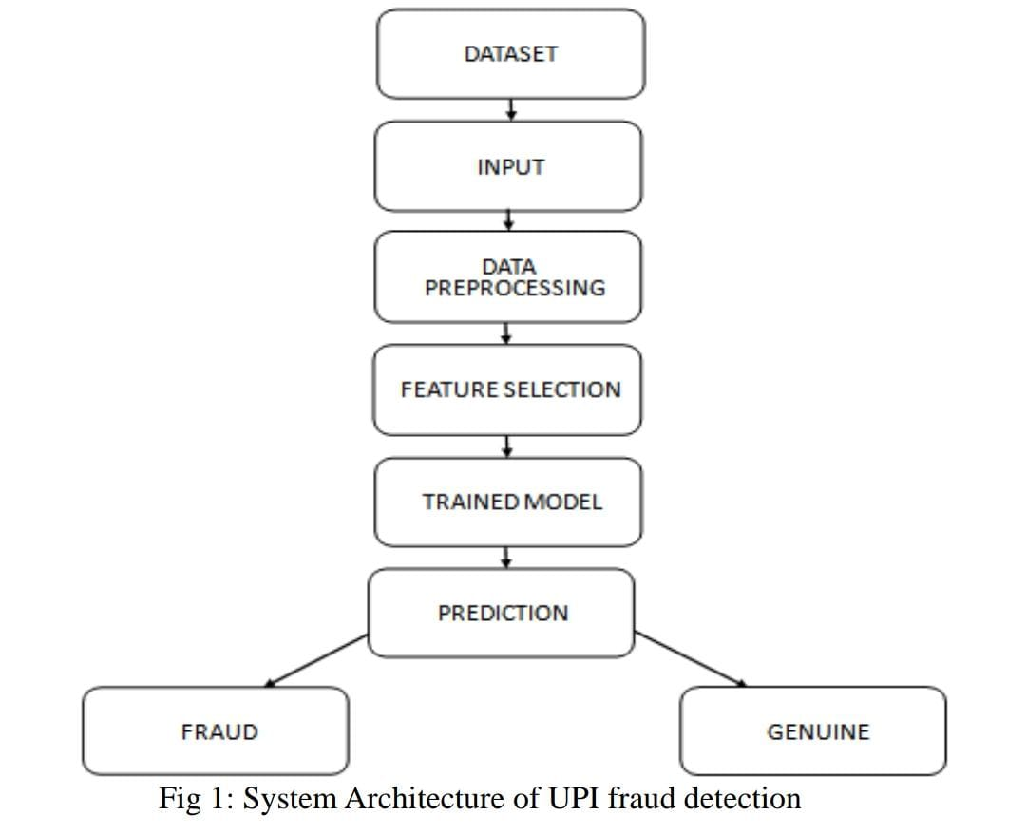
SYSTEM DESIGN
1. SYSTEM ARCHITECHTURE

Slide 17
SYSTEM DESIGN
2. DATA FLOW DIAGRAM
Feature Extraction
Input
Pre-Processing
Classification using SVM
Output
FIG 2: DATA FLOW DIAGRAM

Slide 18
SYSTEM DESIGN
3. SEQUENCE FLOW DIAGRAM
Transaction
Verification
Security
Complete
Transaction
User
Login Info
Transaction Details
Security Info
Result
Verification Details
FIG 3: SEQUENCE FLOW DIAGRAM

Slide 19
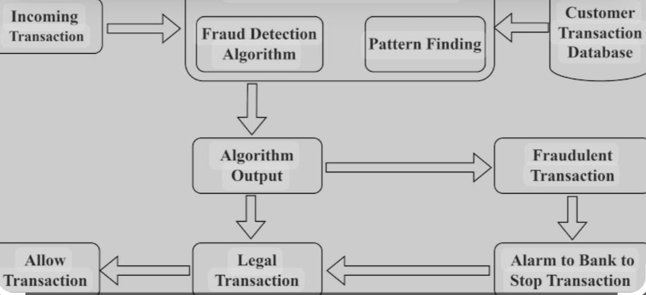
SYSTEM DESIGN
4. CLASS DIAGRAM
FIG 4: CLASS DIAGRAM

Slide 20
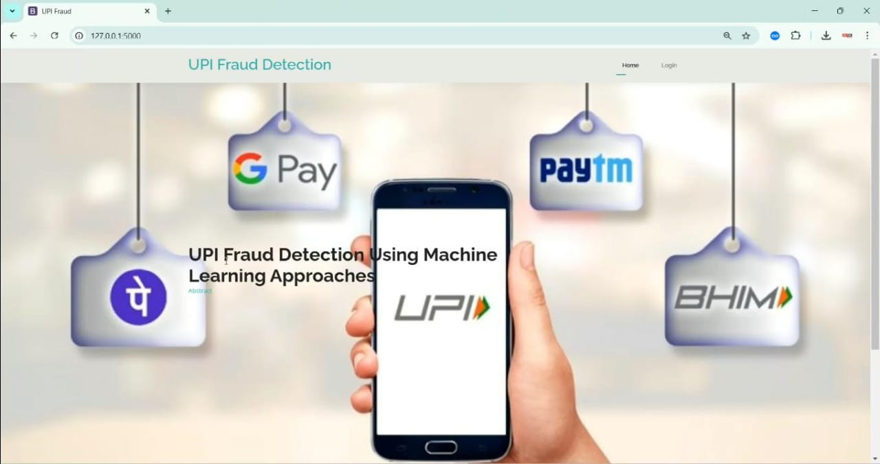
IMPLEMENTATION
HOME PAGE

Slide 21
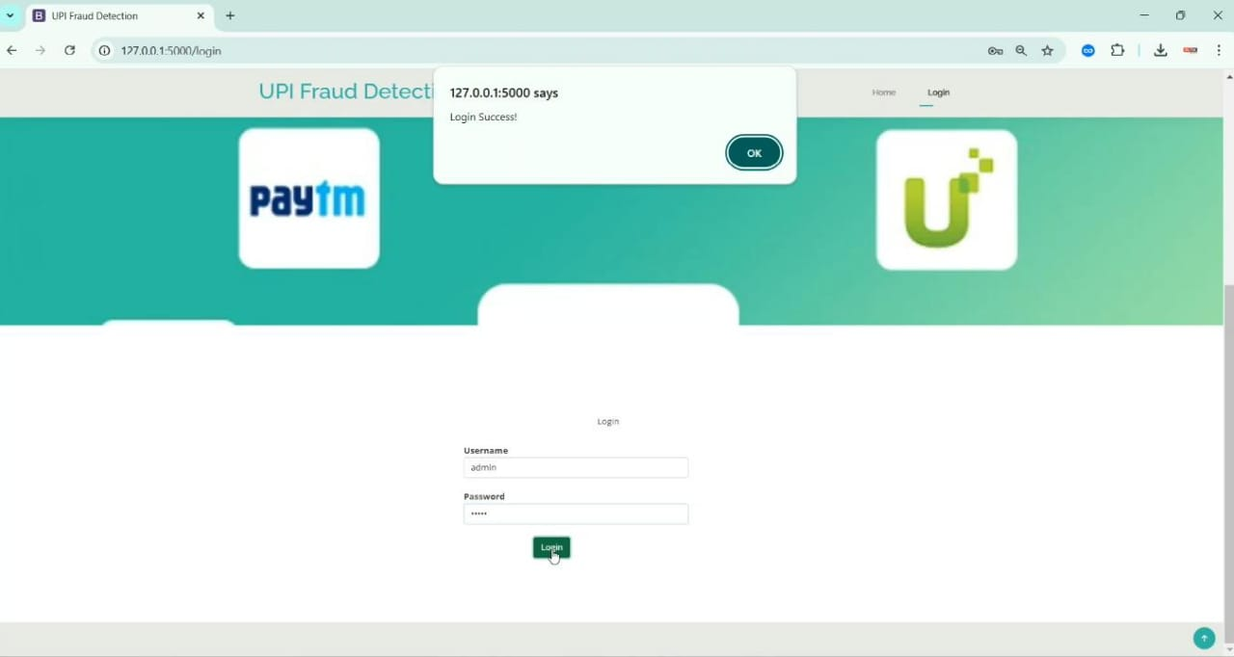
IMPLEMENTATION
LOGIN PAGE

Slide 22
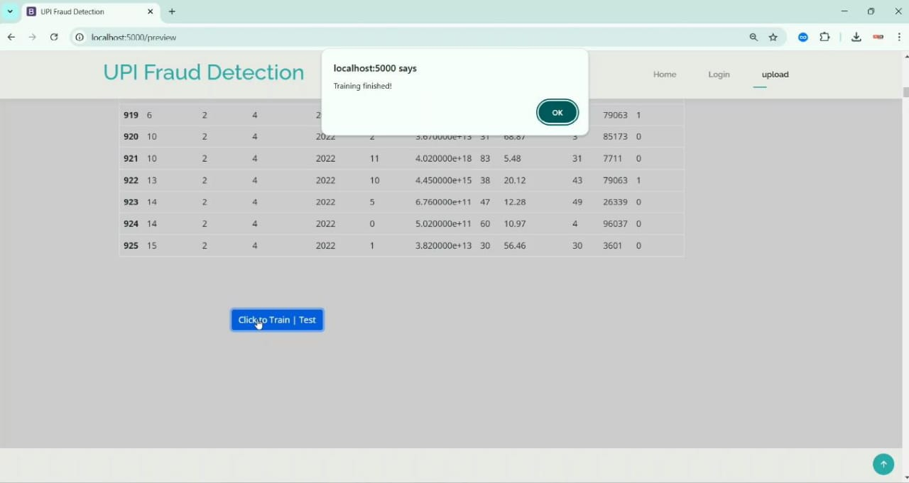
IMPLEMENTATION
UPLOAD DATASET

Slide 23
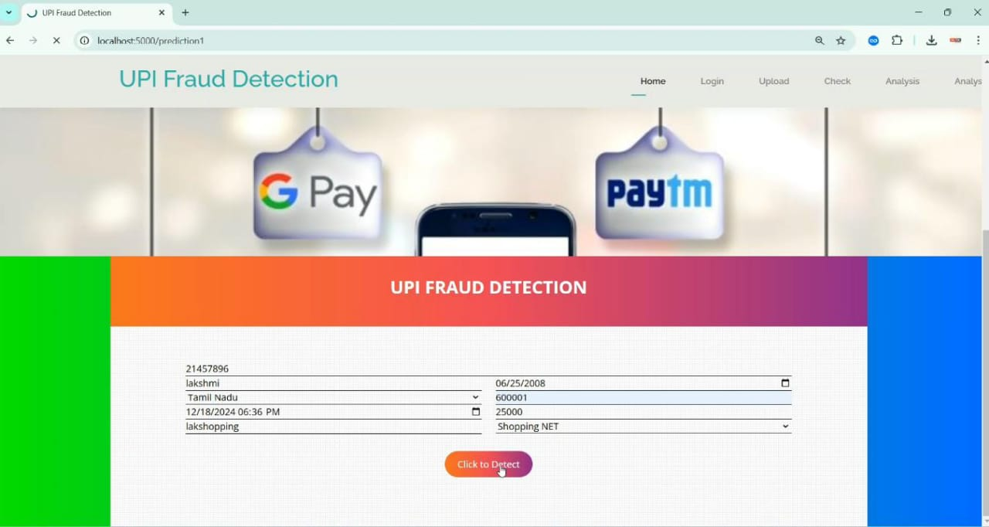
IMPLEMENTATION
Add User Details

Slide 24
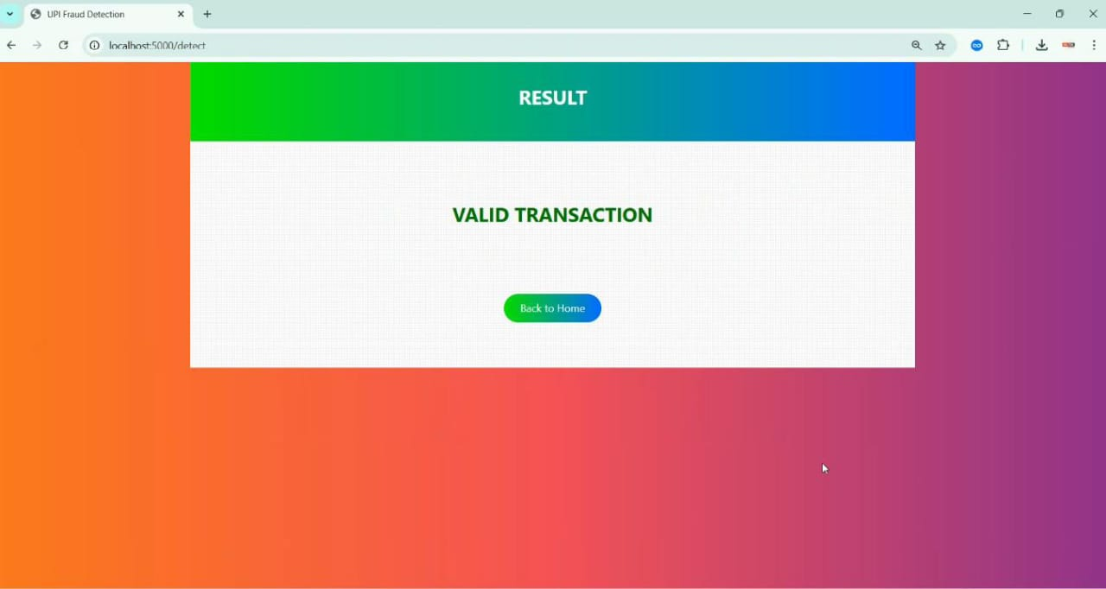
IMPLEMENTATION
VALID TRANSACTION

Slide 25
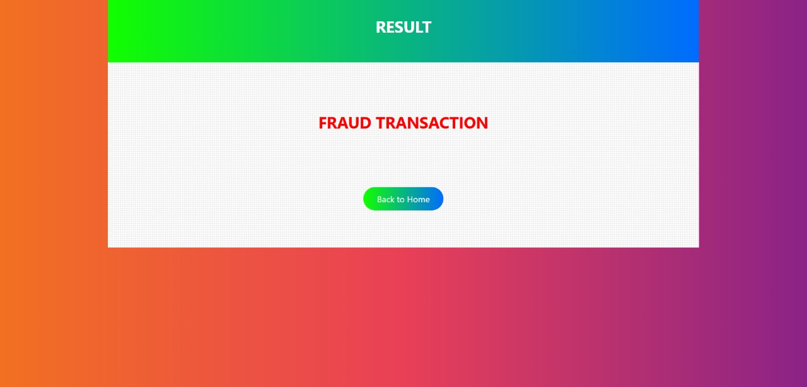
SNAP OF RESULTS
FRAUD REPORTING

Slide 26
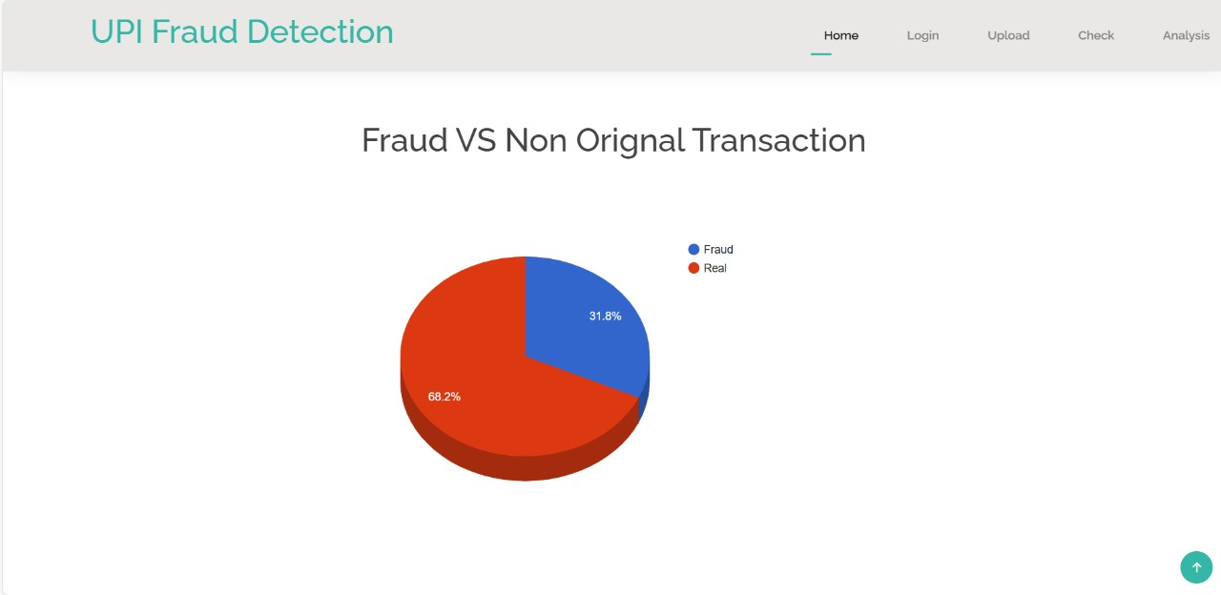
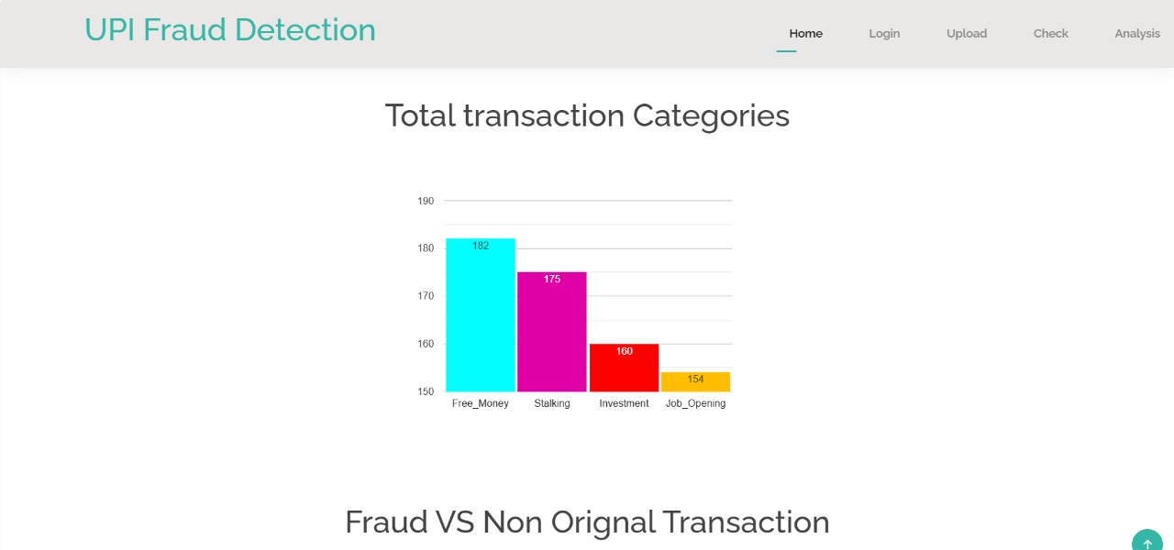
SNAP OF RESULTS

Slide 27
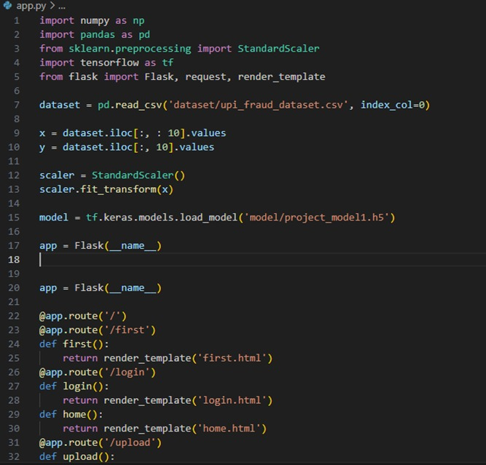
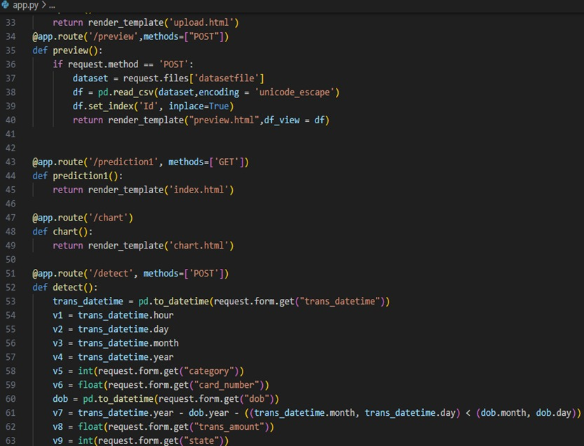
MAIN CODES

Slide 28
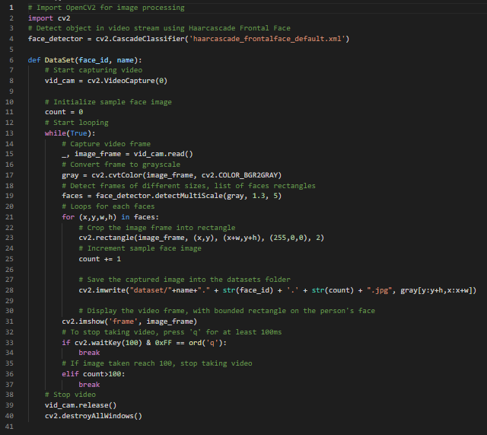

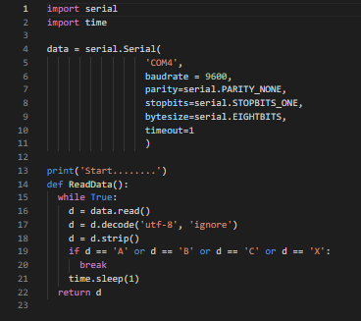
MAIN CODES

Slide 29
CONCLUSION
This project demonstrates the feasibility and effectiveness of using machine learning techniques to detect fraud in UPI transactions. By analyzing transaction data and user behavior in real time, the proposed system can accurately identify fraudulent activities and prevent financial losses. The combination of supervised and unsupervised learning models ensures that the system can detect known fraud patterns while adapting to new, emerging threats. The real-time nature of the system allows for immediate action to be taken, significantly improving security for UPI users.
In the future, the system can be expanded by incorporating additional features such as social network analysis, transaction semantics, and fraud pattern recognition to further enhance its performance.

Slide 30
REFERENCES
UPI Based Mobile Banking Applications – Security Analysis and Enhancements. {Amity University, Noida (India) }
Secure and Privacy Preserving Digital Payment. {Centre for Development of Advanced Computing Bangalore, India}

Slide 31

THANK YOU
Thank you for joining. Stay vigilant and informed to protect yourself and your business from these risks.

